Slide 1
WELCOME
IRB Basics for Students
Kate Boschert
April 2025
IRBadministrator@wpunj.edu

Slide 2
Topics to cover
Purpose of the IRB
What needs IRB Review (and What Doesn't)
How to Submit your Protocol to the WP IRB
  Categories of IRB Review
  Cayuse Human Ethics Module
  Required Elements for a Protocol
WP IRB Review Process

Slide 3
Purpose of the IRB
Provides independent review of research to ensure that the research is ethical, and that participants' rights and welfare are protected for all research being conducted under its authority.
Review research studies to ensure that they comply with appropriate regulations, meet commonly accepted ethical standards, follow institutional policies and adequately protect participants
View: What is an IRB?
  https://www.youtube.com/watch?v=U8fme1boEbE

Slide 4
What is the IRB Responsible for Reviewing?
Research Involving Human Subjects
What is Research? 45 CFR §46.102 (l) and 45 CFR §46.102(e)
(l) Research means a systematic investigation, or interaction including research development, testing, and evaluation, designed to develop or contribute to generalizable knowledge.
  e(2) Intervention includes both physical procedures by which information or biospecimens are gathered (e.g., venipuncture) and manipulations of the subject or the subject’s environment that are performed for research purposes.
  e(3) Interaction includes communication or interpersonal contact between investigator and subjects
Who are Human Subjects? CFR §46.102 (e)
e)(1) Human subject means a living individual about whom an investigator (whether professional or student) conducting research:
  (i) Obtains information or biospecimens through intervention or interaction with the individual, and uses, studies, or analyzes the information or biospecimens; or
  (ii) Obtains, uses, studies, analyzes, or generates identifiable private information or identifiable biospecimens.
Source: 2018 Common Rule: https://www.hhs.gov/ohrp/regulations-and-policy/regulations/45-cfr-46/index.html

Slide 5
What the WP IRB does not Review
(1) Scholarly and journalistic activities (e.g., oral history, journalism, biography, literary criticism, legal research, and historical scholarship)
(2) Public health surveillance activities, conducted, supported, requested, ordered, required, or authorized by a public health authority.
(3) Collection and analysis of information, biospecimens, or records by or for a criminal justice agency for activities authorized by law or court order solely for criminal justice or criminal investigative purposes.
(4) Authorized operational activities (as determined by each agency) in support of intelligence, homeland security, defense, or other national security missions.
Source: 45 CFR 46: 2018 Common Rule: https://www.hhs.gov/ohrp/regulations-and-policy/regulations/45-cfr-46/index.html
(5) Quality Assurance/Quality Improvement activities.

Slide 6
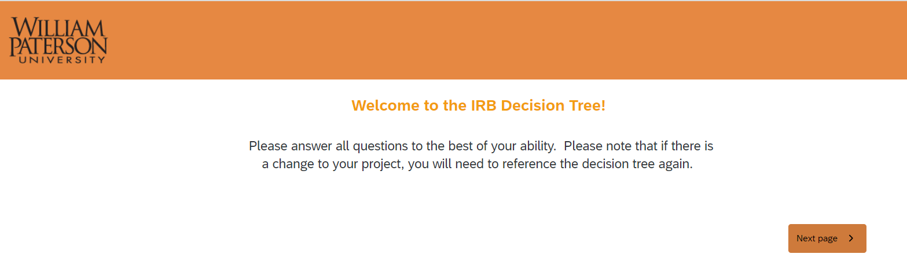
IRB Decision Tool
https://wpunj.qualtrics.com/jfe/form/SV_4JyIifFjmmHOWou?jfefe=new

Slide 7
Steps to Submit to the IRB
Step 5: Monitor Status in Cayuse and WP Email
Step 1: Complete Training
Step 2: Classify your Research Project
Step 3: Prepare your Application in Cayuse
Step 4: Submit and Certify in Cayuse

Slide 8
Training Requirements
CITI Human Subjects Research Training
  CITI Training
  All users must use their William Paterson University email address.
  For Students Complete : Group 3: Human Subjects Research
Cayuse Human Ethics Module Training
  Step by Step Instructions
  Virtual Trainings
  IRB Office Hours

Slide 9
Steps to Submit to the IRB
Step 5: Monitor Status in Cayuse and WP Email
Step 1: Complete Training
Step 2: Classify your Research Project
Step 3: Prepare your Application in Cayuse
Step 4: Submit and Certify in Cayuse

Slide 10
Categories of IRB review
8 Exempt Research Categories
  Based on your application, the IRB will confirm that this research as presented in the application is exempt from further review.
  Exempt research does not require continuing IRB review or other reporting/monitoring.
9 Expedited Research Categories
  Based on your Applicaiton the IRB will confirm that this research as presented in the application meets an expediated review category.
  Expedited research have the following reporting requirements
    Changes to the research protocol require approval in advance
    Protocol deviation, Adverse reaction or events must be reported to the IRB
    At WP Annual continuing review is require (student protocols are administratively closed after 3 year)
Full Board Research:
  Research that does not fall into the exempt or expedited review categories of research
    Typically, research involving greater than minimal risk or research involving vulnerable subjects

Slide 11
 | Quick Overview of the 8 Exempt Categories
Exempt 1: | Normal educational practices in established educational settings
Exempt 2: | Educational tests, surveys, interviews or observation of public behavior.
Exempt 3: | Benign behavioral intervention.
Exempt 4: | Secondary research use of biospecimens or information for which informed consent is not required.
Exempt 5: | Evaluation of public service programs supported by those programs.
Exempt 6: | Taste and food quality evaluation and customer satisfaction studies
Exempt 7: | N/A Storage and maintenance of identifiable materials for unspecified secondary research with broad consent
Exempt 8: | N/A: Secondary research use of stored identifiable materials with broad consent
 | Note: None of these categories apply to prisoners. Some of these categories may not apply to children.

Slide 12
 | Quick Overview of the 9 Expediated Categories
Expedited 1: | Clinical studies of drugs and medical devices only when certain conditions are met.
Expedited 2: | Collection of blood samples by finger stick, heel stick, ear stick, or venipuncture in certain populations and within certain amounts
Expedited 3: | Prospective collection of biological specimens for research purposes by noninvasive means
Expedited 4: | Collection of data through noninvasive procedures (not involving general anesthesia or sedation) routinely employed in clinical practice, excluding procedures involving x-rays or microwaves.
Expedited 5: | Research involving materials (data, documents, records, or specimens) that have been collected, or will be collected solely for non-research purposes
Expedited 6: | Collection of data from voice, video, digital, or image recordings made for research purposes
Expedited 7: | Research on individual or group characteristics or behavior or research employing survey, interview, oral history, focus group, program evaluation, human factors evaluation, or quality assurance methodologies. This is only for research that is non-exempt or not excluded from review.
Expedited 8 and 9: | Continuing review of research previously approved by the IRB that meets certain criteria.
 | Source (OHRP): https://www.hhs.gov/ohrp/regulations-and-policy/guidance/categories-of-research-expedited-review-procedure-1998/index.html

Slide 13
Steps to Submit to the IRB
Step 5: Monitor Status in Cayuse and WP Email
Step 1: Complete Training
Step 2: Classify your Research Project
Step 3: Prepare your Application in Cayuse
Step 4: Submit and Certify in Cayuse

Slide 14
Required Elements to Submit to the WP IRB
CITI Human Subjects Training
Cayuse Access
Cayuse Application: Research Plan
  Plans should uinclude your research question and how you intend to engage with human subjects
  Elements will vary depending on the level of review but be sure to develop a study summary, outline the who, what, where, when and how of your project.
  The Cayuse Workspace will collect all the required elements. This will not be included as an attachment.
  Do not include your draft thesis chapters.
Recruitment Plan and Materials
  How you plan to engage participants in your research
  Include copies of any social media scripts, email/letter template, posters/advertisements, etc.
Informed Consent and Parental Permission/Assent Statement
  Informed consent is the process of providing a subject with adequate information to allow for an informed decision about his or her voluntary participation in the research.
Data Collection Tools
  Include copies of any survey(s), interview questions or checklists, forms or other data collection tools

Slide 15
A Word On Informed Consent
Informed consent is a process where researchers provide potential participants with the necessary information about a study before they agree to participate in the study. The participants must understand what the research involves, including any risks, benefits and their rights.
In your application describe the process to obtains consent and how you intend to document the process.
Informed Consent Forms: OHRP Required Elements for Informed Consent
  General Requirements for Informed Consent (45 CRF 46 116 (a) (1-6)
  Additional Elements of Informed Consent (45 CRF 46 116 (c))
Use the WP IRB suggested templates

Slide 16
More on Informed Consent
Writen/Signed Infomred Cosent
Alteration infomred consent
Waiver of Signed Informed Consent
Waiver of Consent
Participatn will not provide informed conent.
Participant will not be asked to provide sign an informed consent form
Participant will nto be given any infomred consent materials.
Participants will sign and receive a copy of the consent document, but one or more of the basic required elements of consent will be altered or waived
Participants will sign and receive a copy of the the informed consent document which includes all required consent elements
Copy of informed consent document without the signature sections will be provided to participant,

Slide 17
Research Involving Children
Parental Permission
  Research involving children requires both parental consent and child assent.
    If the parent agrees and the child does not; the child cannot be included in research
Assent for Research involving Children
  Assent is a process by which the research obtaining a child’s agreement to participate in research and research activities in an age-appropriate manner.
  WP Assent Template

Slide 18
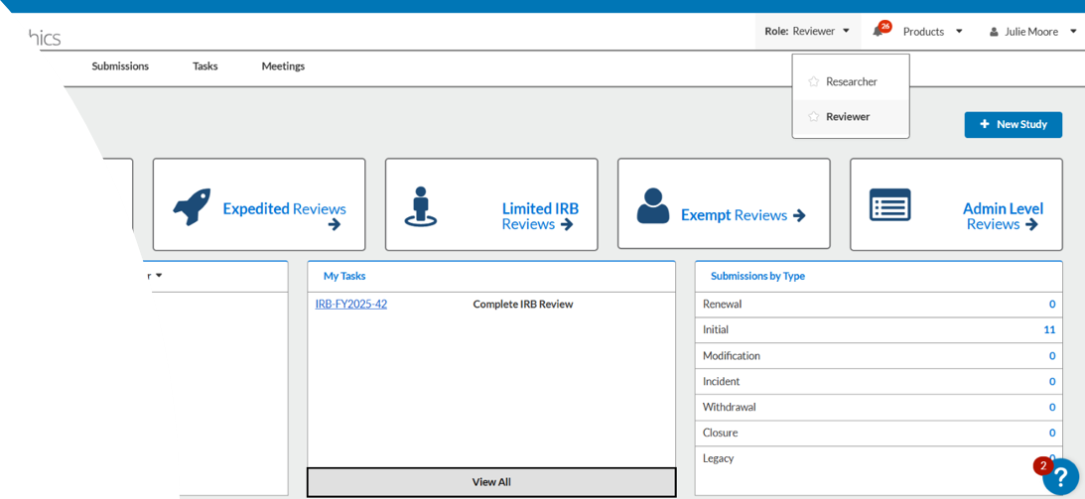
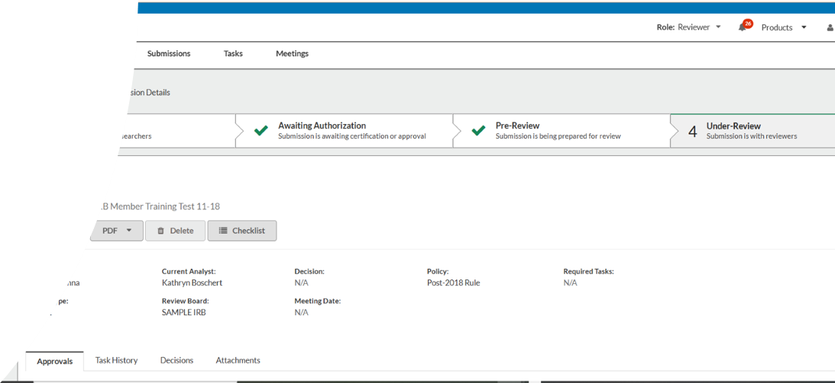
Accessing Cayuse:
For Students
Obtaining a User Account
  Check with you Faculty Advisor to see if you class was registered
  Registration Form to Request aCayuse User Account
    Please allow 3 business days for this account to be created.
One Site For Everyone
Cayuse Human Subjects Website

Slide 19

How to Submit through Cayuse
What is CAYUSE?
An electronic grants management software platform to support sponsored programs and research management in one central system.
Electronically mangos the Human Ethics review process from inhiation to closure.
Integrated One-Stop Shop for Grants and Research Mangement. Modules include:
  Human Ethics
  Outside Interest
  Sponsored Programs
  System to System (grants.gov)

Slide 20
How to Submit your Protocol to the WP IRB
Brief Demo: WP Cayuse
Cayuse UAT

Slide 21
Useful Links
WP IRB Website
CITI Program
IRB Decision Tree
WP Cayuse Human Ethics Information
Cayuse Access Requst Form
WP Cayuse
IRB Consent Forms

Slide 22
Review Process and Status in Cayuse
In Draft
PI must complete all elements the initial form
Awaiting Authorization
Certify required by:
Under Review
Post Review
Review is compelete
Pre-Review
PI and Co-PIs
Students and Faculty Advisor
Completeness Review conducted by IRB Staff
Assigned to an IRB reviwer by IRB Staff member
Approval notice issued
Application is returned for revisions (returns to In Draft)
Check application for completion.
Confirm review category
Confirm review category
Ensure required elements are met.
Two Outcomes:

Slide 23
What to Expect: WP IRB Review Process
All protocols must be reviewed and certified by your faculty advisory and all Co-PIs to move to "Pre-Review".
Review Process takes 3-4 weeks from the time the application is certified.
Only protocols including vulnerable population or greater than minimal risk studies require Full Board Review at the monthly meeting.
NO RESEARCH is PERMITTED until you receive IRB APPROVAL

Slide 24
What to Expect: WP Review Process
Completeness Evaluation (Maureen)
  Incomplete applications will be returned without review.
IRB Member Review
  Protection of Human Subjects and Ethical Conduct of Research: Based on the Belmont Report
    Respect for Persons
      Research participation is voluntary and participants are provided with sufficient information to make an informed decision to participate.
    Beneficence:
      How to minimize the risks to research participants.
    Justice:
      The benefits and burdens of research are shared equally.
  Assess Level of Risk
  Determine Category of Review
  Determine What additional protections are needed (if applicable)
Review Determination Communicated and Approval Notice Issued:
  Approved
  Revisions needed

Slide 25
Knowledge Check
What is the IRB responsible for reviewing?
What doesn't the IRB review?
What materials do you need to submit to the IRB?
How do I submit your protocol to the WP IRB?
What causes delay in IRB protocol review?
What are the three categories of IRB review?
Where can you go for help?

Slide 26

Thank You!
For More Information:
Visit: https://wpunj.edu/osp/irb/
Email:
IRBAdministrator@wpunj.edu

Slide 27
General Requirments for Informed Consent (45 CRF 46 (a) (1-6)
(1) Before involving a human subject in research covered by the WP IRB, an investigator shall obtain the legally effective informed consent of the subject or the subject's legally authorized representative.
(2) An investigator shall seek informed consent only under circumstances that provide the prospective subject or the legally authorized representative sufficient opportunity to discuss and consider whether or not to participate and that minimize the possibility of coercion or undue influence.
(3) The information that is given to the subject or the legally authorized representative shall be in language understandable to the subject or the legally authorized representative.
(4) The prospective subject or the legally authorized representative must be provided with the information that a reasonable person would want to have in order to make an informed decision about whether to participate, and an opportunity to discuss that information.
(5) (i) Informed consent must begin with a concise and focused presentation of the key information that is most likely to assist a prospective subject or legally authorized representative in understanding the reasons why one might or might not want to participate in the research. This part of the informed consent must be organized and presented in a way that facilitates comprehension.
(5) (ii) Informed consent as a whole must present information in sufficient detail relating to the research and must be organized and presented in a way that does not merely provide lists of isolated facts, but rather facilitates the prospective subject's or legally authorized representative's understanding of the reasons why one might or might not want to participate.
(6) No informed consent may include any exculpatory language through which the subject or the legally authorized representative is made to waive or appear to waive any of the subject's legal rights, or releases or appears to release the investigator, the sponsor, the institution, or its agents from liability for negligence.

